Slide 1

GLOBACOM SIM-REG ACTIVITY REPORT
By Jacinta Ejiofor
April, 2020

Slide 2
Introduction
This report breaks down some key activities that have happened on the Globacom DB this past week (19-04-2020 – 25/04/2020).

Slide 3
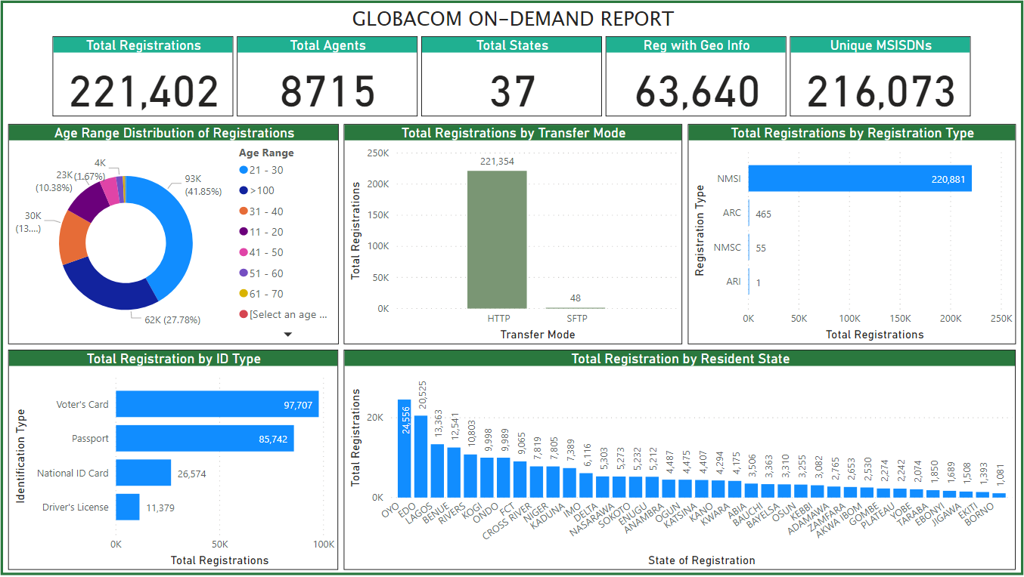
Why do we have so many registrations of people older than 100? Is this a realistic expectation or is it driven by the corona virus pandemic? Oyo, Edo and Lagos – all Western states- recorded the most registrations for the week in consideration.

Slide 4
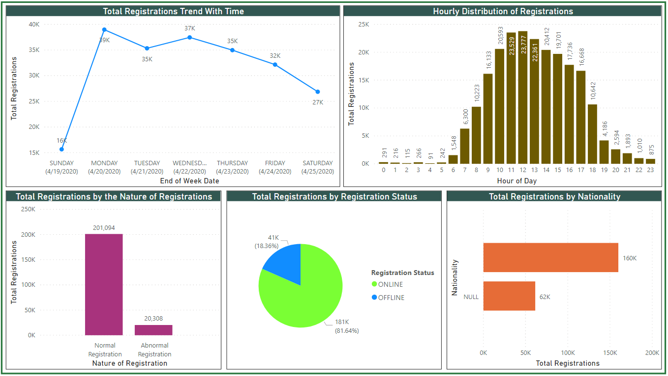
Sunday has the lowest number of registrations which is in line with previous records. The most active time for file synchronization is between 8am – 6pm. Why are we not capturing Nationality information?

Slide 5
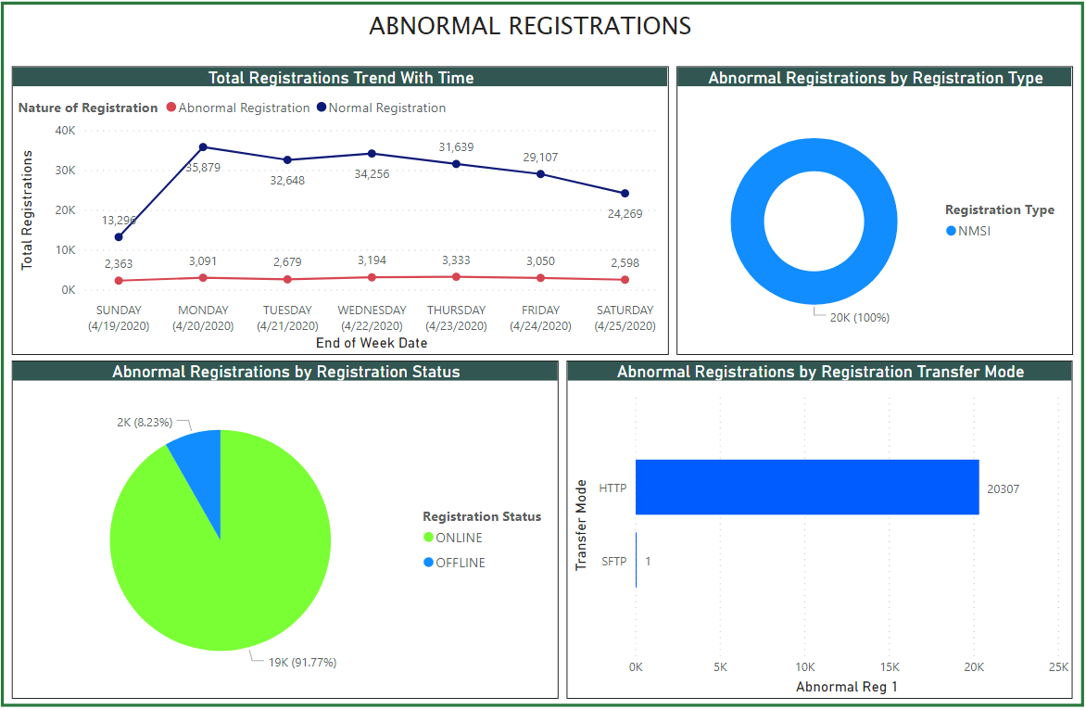
For the week in consideration, the registrations were all NMSI registration types, mostly occurred via HTTP transfer mode and for the most part happened online. It is too soon to identify a pattern. **Registration records with non-matching file synchronization dates and registration dates are classified as Abnormal Registrations **

Slide 6
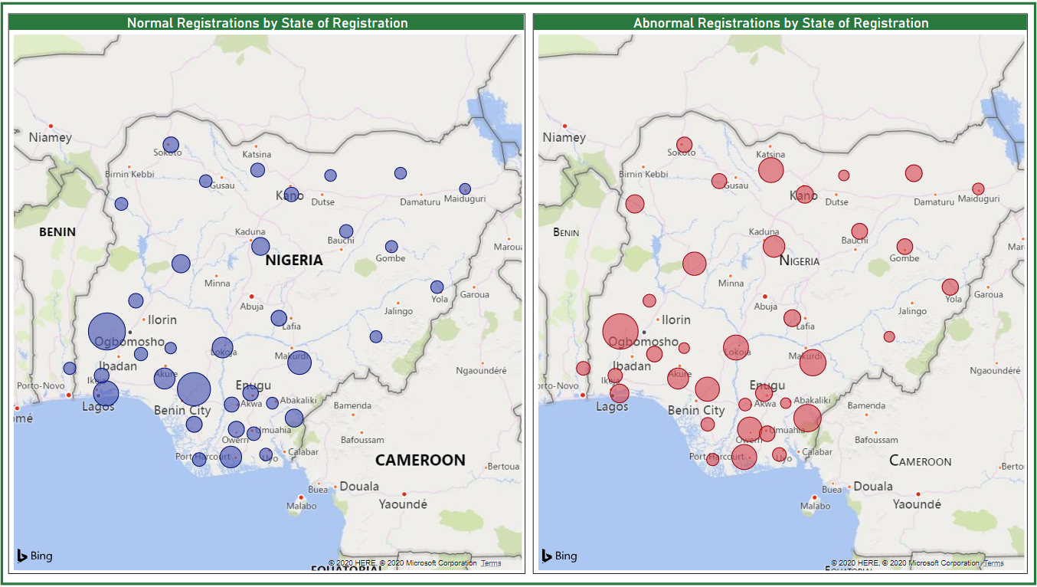
Comparing the graphical representations of all the normal registrations with those of the abnormal registrations, it is apparent that abnormal registrations happen in all states. More info on this is provided on slide 10. The size of the bubbles on the chart shows the total number of registrations for that state in respect to the total number. That is why the bubble for Katsina on the left is more than that on the right despite the total on the left being higher.

Slide 7
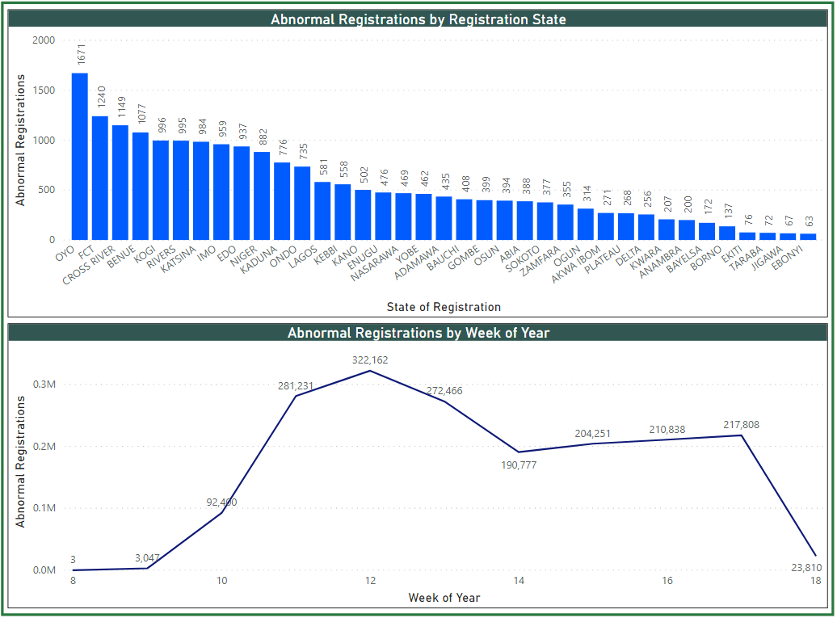

Slide 8
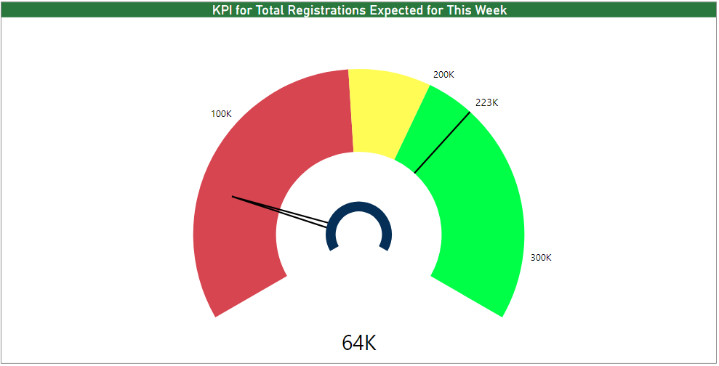
This chart shows the predicted number of registrations expected for the week based on the weekly averages of the registrations we have processed so far.
There are three color ranges: red, yellow and green. Red is the unacceptable range, Yellow is the manageable range while Green is the desired range.
This report says that we expect to hit 223k registrations by the end of the week but we are currently at 64k.

Slide 9
IMPORTANT METRICS
Nature of Registration | Total Registrations | Capture2Sync Time | Capture2Mcentric Time | Sync2Backend Time
Abnormal | 20,308 | 93 days, 10minutes & 39 seconds | 93 days, 14 minutes & 1 second | 9 seconds
Normal | 201,094 | 31 minutes & 54 seconds | 41minutes & 57 seconds | 8 seconds
Nature of Registration | Total Registrations | Backend2Mcentric Time | Capture2Backend Time
Abnormal | 20,308 | 3 minutes & 13 seconds | 93 days, 10 minutes & 48 seconds
Normal | 201,094 | 11 minutes & 24 seconds | 32 mins & 3 seconds
It might interest you to know that from Sunday (19th ) till Wednesday (22nd), the average sync2BackendTime was less than a second for both Abnormal and Normal registrations. This number started to increase significantly from Thursday between the range of 18seconds – 22seconds.
Metrics Explanation
Capture2Sync: Time it takes for SIM registration to move from client device to the SFTP Server/Sync Processor server.
Capture2Mcentric: Time it takes for SIM registration to move from a client device to the SFTP Server, be processed into the database and then pushed to the MCentric server.
Sync2Backend: Time it takes for BFP or Sync Processor to process a registration from the SFTP server into the database.
Backend2Mcentric: Time it takes for registration to be pushed from our database to the MCentric server.
Capture2Backend: Time it takes for SIM registration to move from a client device to the SFTP Server and be processed into the database.

Slide 10
Concluding Remarks
A lot of these abnormal registrations were captured at earlier dates and then uploaded later. This seems to be a common practice for agents. Some of these records with extreme dates (like ’01-01-1980’ and ‘01-04-2080’) are obviously bad dates. Altogether, these dates skew performance metrics and make it look like the system is inefficient. We should look into how this can be eradicated. For now, I have found a way to evaluate the performance of the system and this can be seen in the previous slide.
We don’t store nationality data. Is this a deliberate decision or an oversight?
Business should determine the appropriate definition of what an ‘abnormal registration’ is if my definition does not apply.

